Slide 1

Prepared by group 9
Group Project
House Price Estimation
29 May, 2025

Slide 2




Team Members
Md. Rayhan Ahmed Shis (2125051067)
Batch- 50
Section- 7C1
Mohammad Shakibul Hasan (2215151115)
Batch- 51
Section- 7C1
Jarin Jubuyer Jui (2215151141)
Batch- 51
Section- 7C2
MOST. Nasrin Akter (2215151142) (c2)
Batch- 51
Section- 7C
Submitted To:
Saima Siddique Tashfia
Lecturer, Dept. of CSE ,Uits

Slide 3
Introduction
In today’s fast-paced and data-driven world, knowing the right price for a house can make a big difference —
whether you're buying, selling, or investing. This project takes a practical approach to that challenge by using
a linear regression model to estimate house prices based on real factors like the number of rooms, total area,
and property location. By analyzing historical data and applying statistical techniques, the goal is to uncover
patterns and relationships that help predict how much a house is likely to cost.

Slide 4
Objective
Build a predictive model using linear regression to estimate house prices.
Clean and preprocess the dataset by handling missing values and converting non-numeric data into usable formats.
Evaluate how well the model performs using both training and testing datasets.
Implement everything in MATLAB, and generate results that are ready for submission or deployment.

Slide 5

Tools
Programming Language: MATLAB
Libraries/Functions: Basic MATLAB built-in functions (readtable, fitlm, etc.)
Datasets: train.csv, test.csv (provided in the project)
Platform: MATLAB Simulation Environment

Slide 6

Expected Outcomes
A functional MATLAB-based model capable of predicting housing prices
Cleaned and structured dataset for model input.
Prediction output file (submission.csv) aligned with competition or evaluation standards.
Source code and methodology that can be adapted for similar regression problems.

Slide 7

Methodology
Data Acquisition:
Import training and test data using MATLAB’s readtable() function.
Data Preprocessing
Clean and transform data using a custom function replace_func.m to handle missing and categorical values.
Model Development
Pilot the proposed strategies on a smaller scale to assess their effectiveness.
Gather feedback, iterate, and refine the strategies based on initial results.
Prediction and Output Generation
Generate price predictions using the trained model and export results to submission.csv.

Slide 8
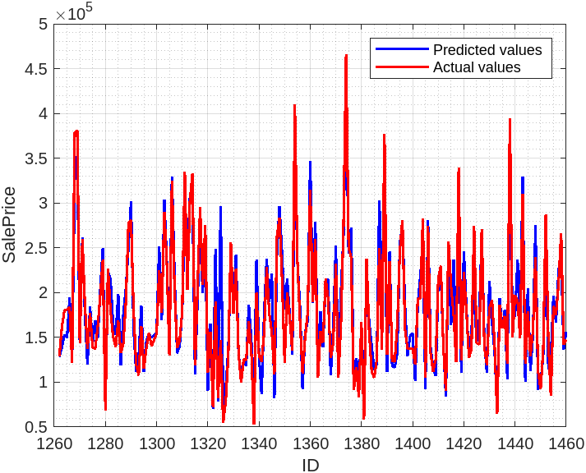
Data Analysis
In this study, we used MATLAB to develop a linear regression model that predicts house prices based on various features such as area, number of rooms, location, and more.
The graph shows a comparison between the actual and predicted sale prices for a portion of the dataset.
Red Line – Actual Sale Prices
Blue Line – Predicted Sale Prices
The predicted values closely follow the actual trend, indicating a well-fitted regression model.
Some deviations are present, which can be attributed to outliers or unaccounted features.
The model performs reasonably well, but further tuning or feature engineering could improve prediction accuracy.

Slide 9
Conclusion
This project demonstrates the potential of linear regression for data-driven real estate price prediction.
Despite certain limitations (e.g., feature scope and lack of regularization), the model produces interpretable and usable results.
Future improvements can include:
Advanced ML models (e.g., Lasso, Random Forest)
Feature engineering and selection
Integration into real-time applications (web/mobile)

Slide 10
Thank you

